Slide 1


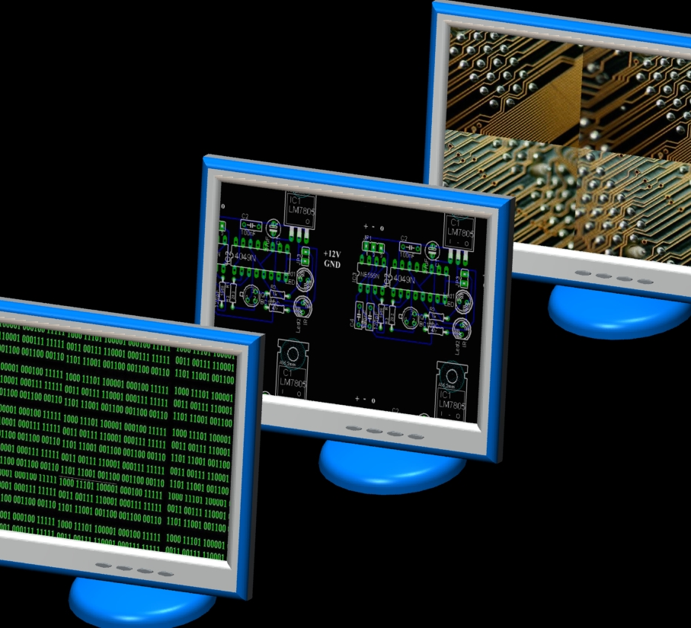
COM1025 Web & database systems
Lecture 2
Dr Mariam Cirovic
CSEE

Slide 2
Last Week
We considered the foundations of how the internet works
We created some simple JavaScript programs. We ran these programs in the Node.js environment.
However, we did not use any Node.js features. We just used JavaScript features.
Notes:
Develop students' understanding of the theory, design, and development of database systems and the key role database systems play in the real world
Equip students with the basic knowledge of frontend and backend web technologies that can be used to interface a database system
Develop students' analytical and problem-solving skills via modelling data of real-world problems
Perspective of the designer and developer of db systems

Slide 3
This Week
This week, we will be learning about Node.js features, and why we need them
Specifically, we will consider:
How to create simple web applications
Using templating languages
Using a package manager
Using a web framework
Notes:
We will be learning about the Node Package Manager (npm)

Slide 4
By the end of the week
You’ll be able to complete the following assessment tasks:
8. Application Structure [3 Marks]
10. A Minimum of 4 User-facing Routes Served [4 marks]
11. Construct EJS Views for the 4 Routes [3 marks]
Notes:
We will be learning about the Node Package Manager (npm)

Slide 5
The anatomy of a node project
Notes:
“Learn about the key technologies of Database systems and the World Wide Web (WWW)”. Why is the important?
Databases are the core component of most computer application.

Slide 6
A Typical Node.js Project
A node project is a folder that contains a package.json file.
The package.json file contains information about the project, including the packages it uses.
A package.lock file contains information about the packages that are installed in the project
There should be at least one JavaScript that will be the entry point for your application: e.g., index.js, app.js
| ── my-project
|── package.json
|── package-lock.json
|── node_modules
|── index.js

Slide 7
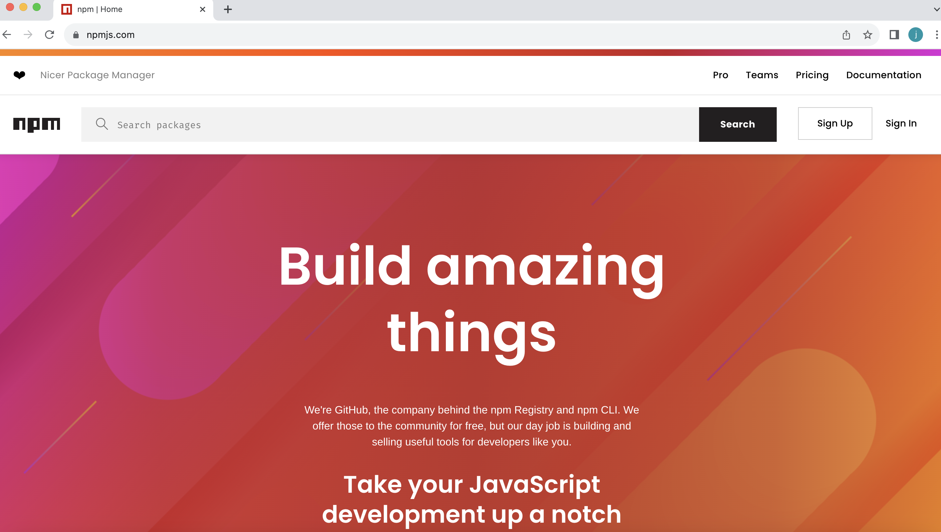
The Node Package Manager
The node package manager can be used to manage node projects (https://www.npmjs.com/)

Slide 8
The Node Package Manager(NPM)
npm is:
a package manager for JavaScript
if you have Node.js installed, you have npm installed!
the world's largest software registry
it provides a command-line interface (CLI) for managing packages and other tasks
it can be used to install, manage, and publish packages, manage dependencies, and run scripts

Slide 9
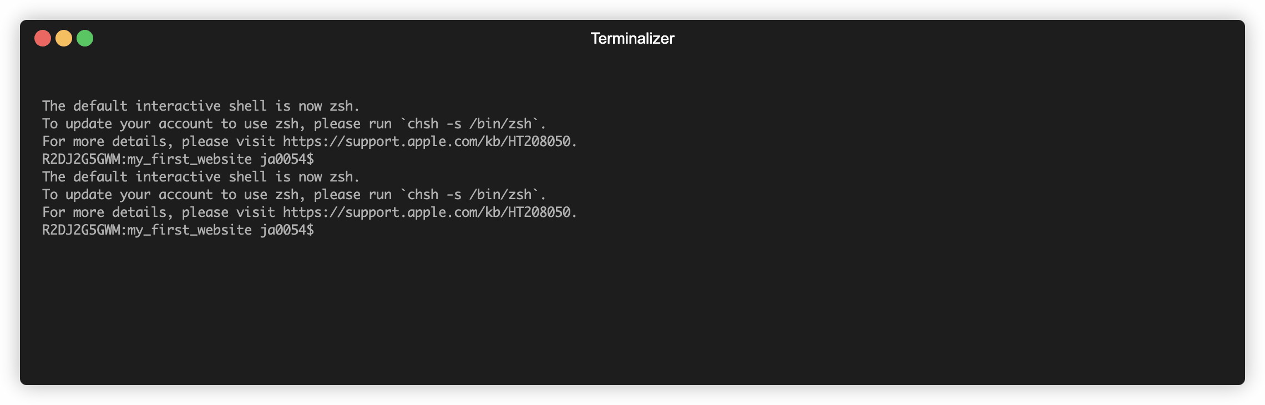
Getting Started with NPM
- Ensure your have NodeJS installed
- In the directory of your project run the terminal command: npm init
- You can keep pressing enter to accept the defaults.

Slide 10
You now have a package.json file
{
"name": "my_first_website",
"version": "1.0.0",
"main": "index.js",
"scripts": {
"test": "echo \"Error: no test specified\" && exit 1"
},
"author": "",
"license": "ISC",
"dependencies": {
},
"devDependencies": {},
"description": ""
}
The `package.json` file contains information about the project and is split into sections.
For this module, there are only three sections we care about:
The `devDependencies` field is a list of packages that the project depends on in development mode.
The `dependencies` field is a list of packages that the project depends on.

Slide 11
Getting Started with NPM
After running “npm init”; we can now install some packages
You can find packages by searching the https://www.npmjs.com/
Repository
Packages are open source and free
There are over 1.2million packages
Many are downloaded millions of times a week

Slide 12
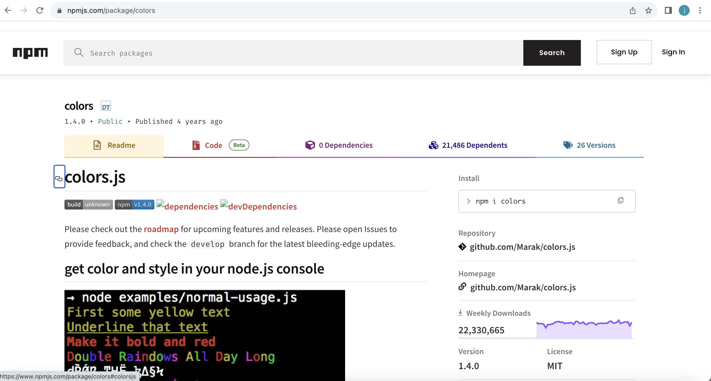
Let’s Install Colors (i)
This package lets us print different colors to the console
Name of the package
The source code
Documentation
Downloads

Slide 13
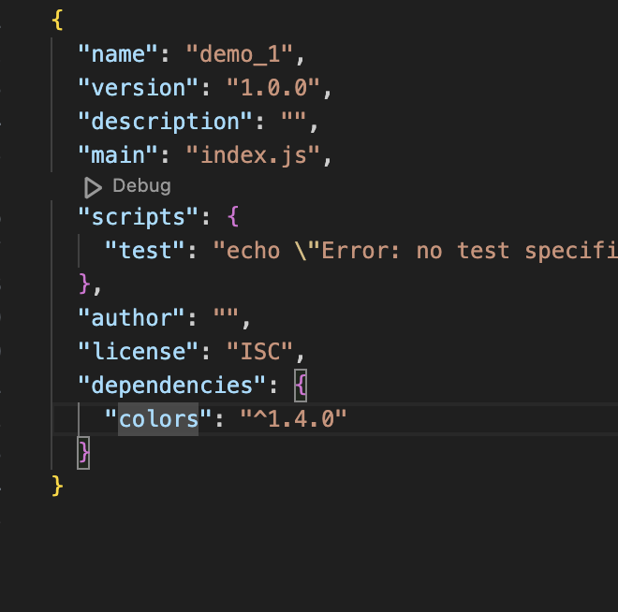
Let’s Install Colors.js (ii)
Dependencies are installed from command line.
Ensure your terminal window is pointed to the root of your project.
> npm install colors
Packages are stored in the "node_modules" folder
Dependencies listed in the ”package.json” file
Packages are stored in the "node_modules" folder

Slide 14
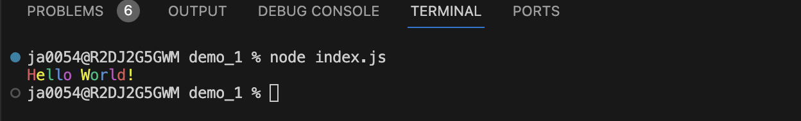
Using Packages
const colors = require('colors’); // save the package to a const
console.log('Hello World!'.rainbow);

Slide 15
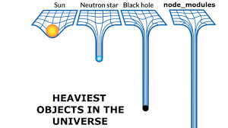
Some TIPS
Since packages have dependencies the ”node_modules” folder gets very heavy
Use .gitignore to exclude "node_modules" from version control
Delete the ”node_modules” folder before submitting your assessment
We can install the dependancies by running “npm install”

Slide 16
DEMO
Notes:
“Learn about the key technologies of Database systems and the World Wide Web (WWW)”. Why is the important?
Databases are the core component of most computer application.

Slide 17
Web Development Frameworks
Notes:
“Learn about the key technologies of Database systems and the World Wide Web (WWW)”. Why is the important?
Databases are the core component of most computer application.

Slide 18

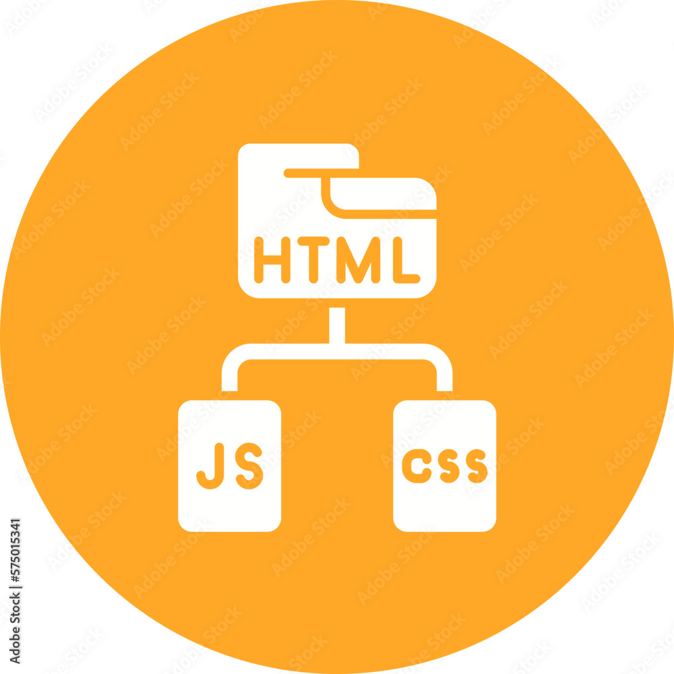
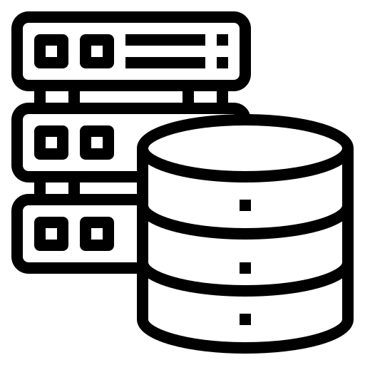
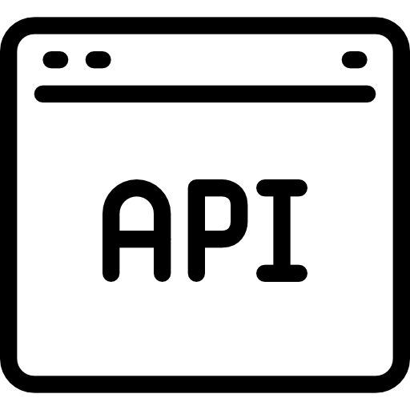
Front end vs back-End Development
Front-End:
HTTP Requests
Back-end:

Slide 19
WEB FRAMEWORKS
Web Frameworks Simplify the process of web development
They abstract low-level details
Common web frameworks include:
Express.js (Node.js)
Django (Python)
Ruby on Rails (Ruby)
Flask (Python)
Laravel (PHP)
Spring Boot (Java)
This is what we will use

Slide 20

A minimal and flexible Node.js web application framework
Express includes a routing system that enables developers to define routes for different HTTP methods and URLs.
Makes it easy to create a structured and organized API or web application with specific endpoints.
Express can be integrated with various template engines, such as EJS or Pug.

Slide 21
Creating and Express Application
> npm install express
const express = require("express");
const app = express();
const port = 3000;
app.get("/", (req, res) => {
res.send("Hello World!");
});
app.listen(port, () => {
console.log(`Example app listening at http://localhost:${port}`);
});
The above example uses the express package to create a new web-server that listens on port 3000. We can then set up listeners to respond to any given HTTP request.

Slide 22
Serving HTML files
const express = require("express");
const path = require("path"); // this is a built in node package
const app = express();
const port = 3000;
app.get("/", (req, res) => {
res.sendFile(path.resolve(__dirname, "index.html"));
});
app.listen(port, () => {
console.log(`Example app listening at http://localhost:${port}`);
});
Above, we return an index.html file when a request is received to the root of our website.
path.resolve is a Node.js method that resolves a sequence of path segments into an absolute path
e.g., if your current directory is “/user/example” the output would be “/user/example/index.html”

Slide 23
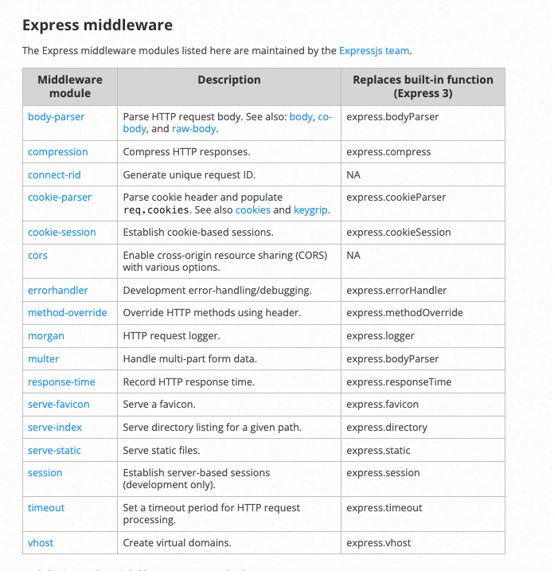
Using the Static Middleware
Currently we cannot serve static assets such as CSS and images in our HTML pages.
We are only sending a single HTML file, not linked assets (e.g., images, css, and JavaScript)
To configure this functionality, we need to use some middleware.
Middleware can is bult into express, and there is also third-party modules you can use
We can use middleware to handle concerns such as

Slide 24
Serving Static Assets
Below, we instruct express to serve assets from a folder in our root directory called public
Note, use “express.use” to set up middleware
const express = require("express");
const path = require("path");
const app = express();
app.use(express.static(path.join(__dirname, "public")));
Above, express looks up the files relative to the static directory public:
the name of the static directory is not
if we place the image foo.jpeg in the public folder we would reference it in index.html like this, <img src="foo.jpeg" />.

Slide 25
DEMO
Notes:
“Learn about the key technologies of Database systems and the World Wide Web (WWW)”. Why is the important?
Databases are the core component of most computer application.

Slide 26
What’s wrong with just HTML
Serving plain HTML files provides us with a means to present a website
How do we inject data into our html pages?
Shared components or layouts must be replicated across different HTML files
As web applications grow in complexity, maintaining a large codebase written in pure HTML becomes increasingly challenging.
The lack of a clear separation of concerns makes it difficult to manage the presentation layer independently from the application logic

Slide 27
Templating to the Rescue
Templating allows for the dynamic generation of content in web applications
Templating promotes code reusability by separating the HTML structure from the data
Shared components
Templating ensures consistent layouts across different pages of a website.
Some popular templating languages include: EJS, Handlebars, Mustache , and Pug

Slide 28
Express supports templating
We’ll use EJS
EJS is simple to use. First, we need to install it:
> npm install ejs
We can now tell express to render our html pages using ejs. Below is a full example.

Slide 29
Using EJS (i)
const express = require("express");
const path = require("path");
const app = express();
const port = 20000;
app.set("view engine", "ejs");
app.use(express.static(path.join(__dirname, "public")));
app.get("/", (req, res) => {
res.render("index");
});
app.listen(port, () => {
console.log(`Example app listening at http://localhost:${port}`);
});

Slide 30
Using EJS (iI)
Express will assume that we have an index.ejs file in a views folder which lives in the root directory of your project.
EJS, is a superset of HTML. This means, to get the above example to work, we can simply rename our any html file to index.ejs and move it to a views folder.
Using EJS, we now have some dynamic capabilities within our HTML views.

Slide 31
EJS Allows HTML to be chunked
<!-- views/common/header.ejs -->
<ul>
<li><a href="home">Home</a></li>
<li><a href="about"></a>About</li>
<li><a href="contact">Contact</a></li>
</ul>
<!-- views/index.ejs -->
...
<body>
<%- include('common/header'); %>
<h1>Home Page</h1>
<img src="test.jpeg" alt="wtf" />
</body>
...

Slide 32
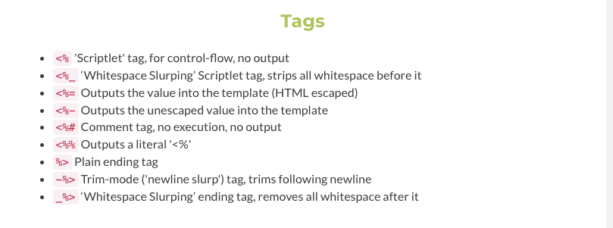
Different types of Tags
We will investigate more dynamic EJS tags next week
You can get a full list of tags from the EJS docs:

Slide 33
DEMO
Notes:
“Learn about the key technologies of Database systems and the World Wide Web (WWW)”. Why is the important?
Databases are the core component of most computer application.

Slide 34
End of lecture
Notes:
“Learn about the key technologies of Database systems and the World Wide Web (WWW)”. Why is the important?
Databases are the core component of most computer application.

